Slide 1
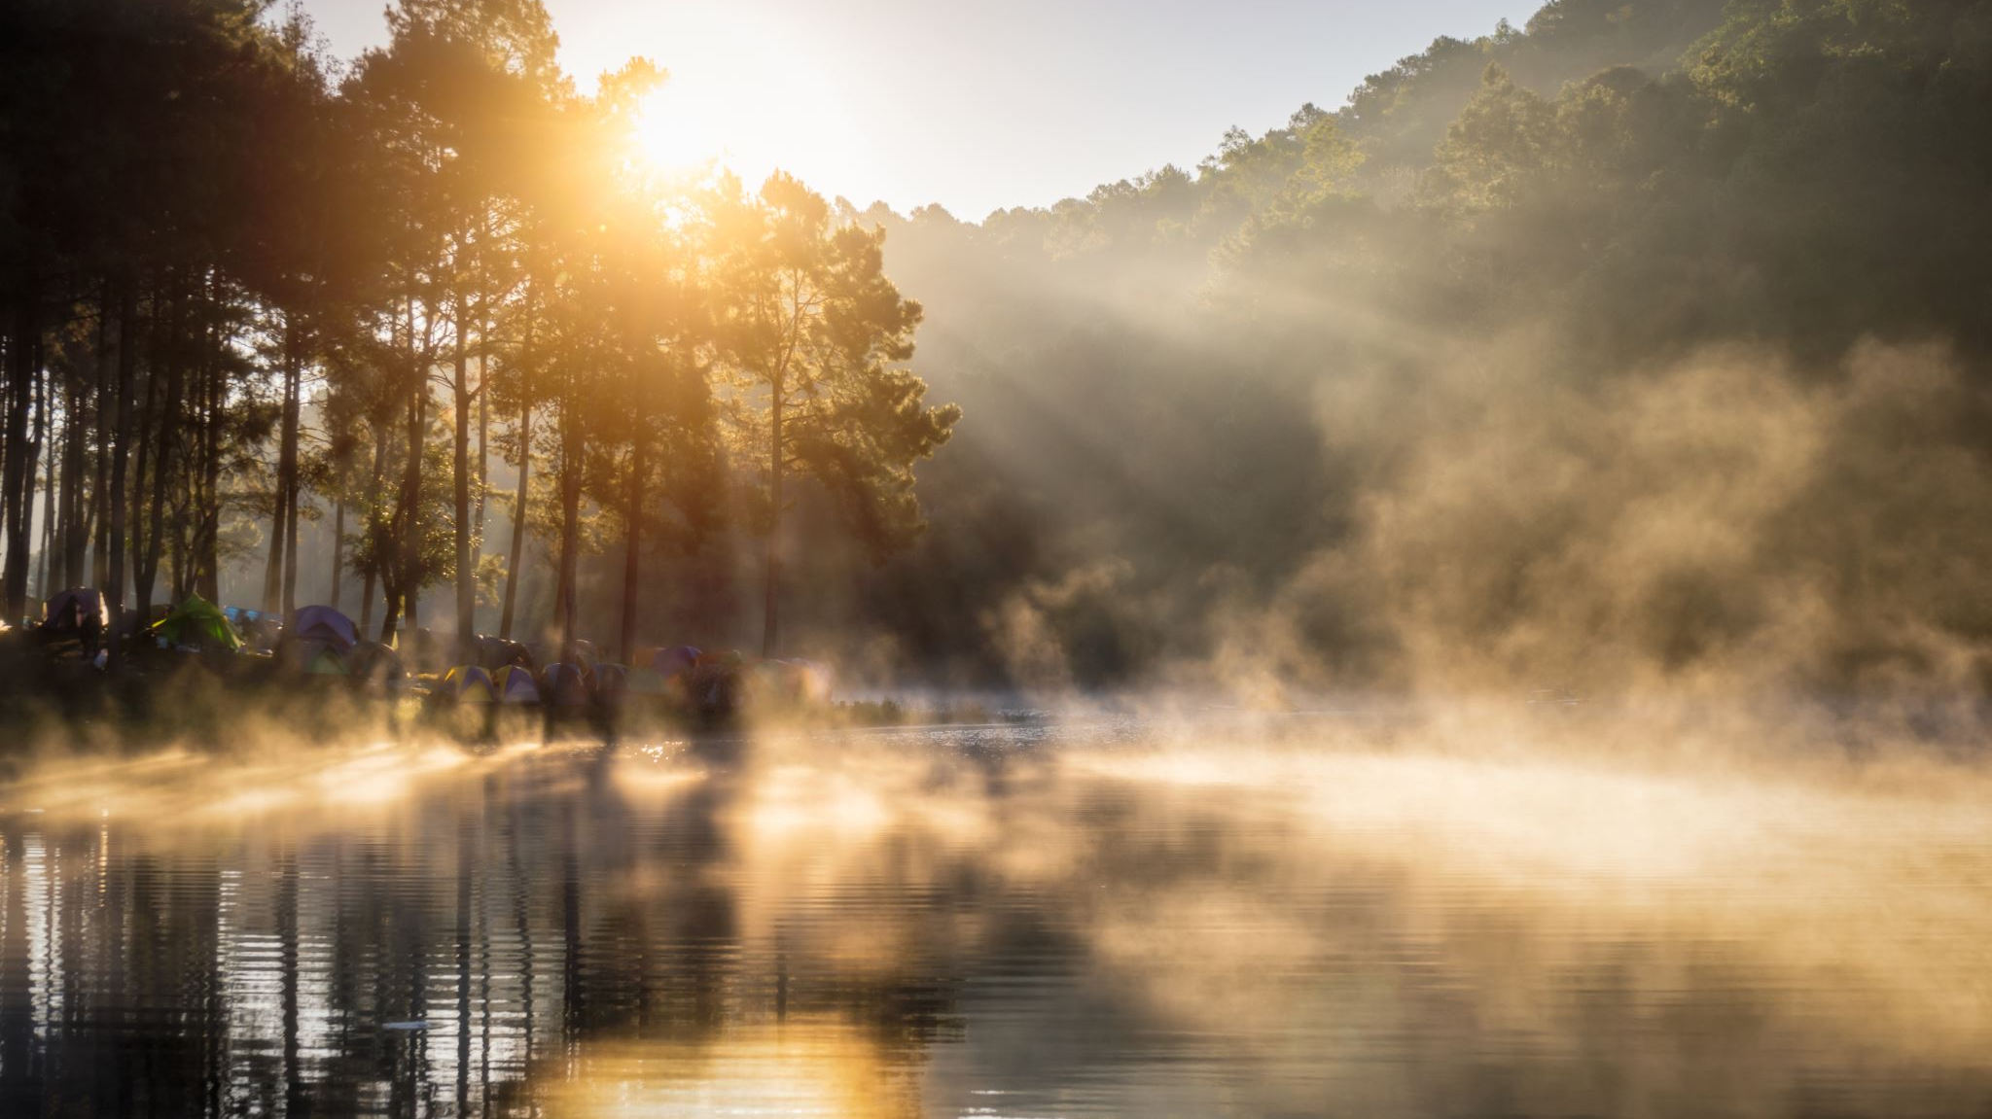
MY DAY
IGOR PRIMARY SCHOOL 82 IN CRACOW

Slide 2
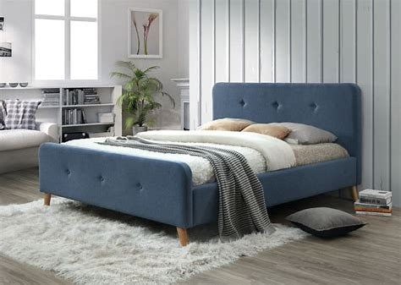
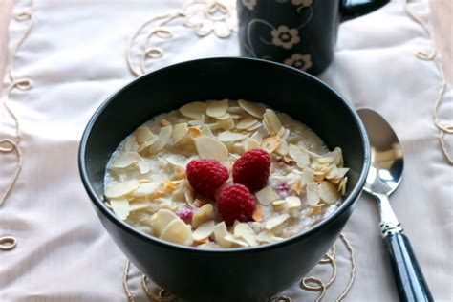
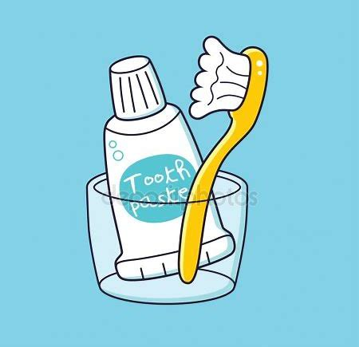
1.MORNING
I GET UP AT 6.30 AND THEN I MAKE MY BED AND DRESS UP.
ABOUT 6.50 I ALWAYS EAT BREAKFAST. IN THE NEXT, I AM BRUSCH MY TEETH.

Slide 3
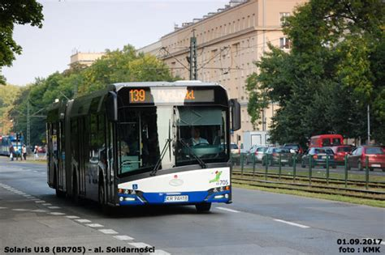
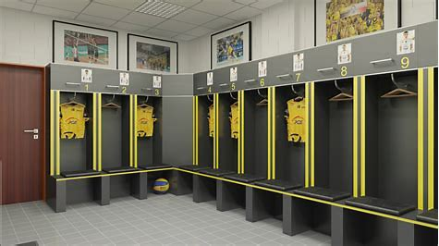
2.GO TO SCHOOL
I HAVE A BUS AT ABOUT 7.25
I AM AT SCHOOL ABOUT 7.35.
I GO TO CLOAKROOM, CHANGE MY
CLOTHES AND WAIT FOR LESSONS.

Slide 4
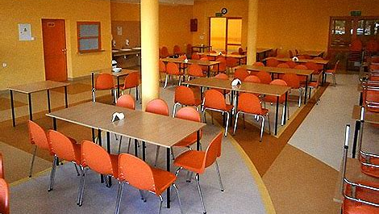
3.SCHOOL
I HAVE 5/6 LESSONS A DAY.
I ALWAYS EAT DINNER WITH MY FRIENDS AT THE SCHOOL CANTEEN AT 11.30

Slide 5

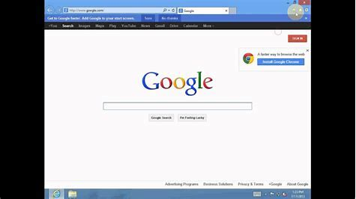
4. BACK TO HOME
I END MY LESSONS AT 1.30 OR 12.30.
I GO BACK HOME BY BUS OR TRAM WITH A CHANGE. I AM AT HOME AT 1.00 OR 2.00. WHEN I AM BACK HOME I ALWAYS WATCH TV AND SURF THE INTERNET.

Slide 6

5.STUDY
AT 4 o CLOCK, I START STUDYING AND I DO MY HOMEWORK.

Slide 7
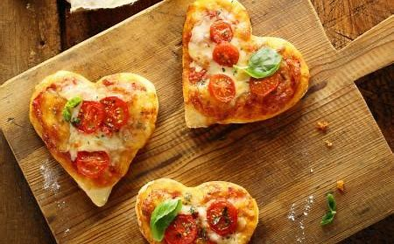
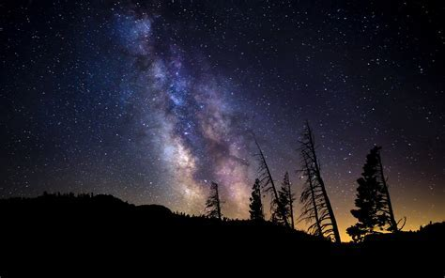
6.EVENING
I ALWAYS EAT MY SUPPER AT 9 o CLOCK. HALF AN HOUR LATER I HAVE A SHOWER AND AT 10 o CLOCK I GO TO BED.

Slide 8

THANK YOU FOR YOUR ATTENTION!!!

Slide 9
BIBLIOGRAPHY
MIRAT.EU
LEKKOWKUCHNI.PL
DEPOSITPHOTOS
KMK.KRAKOW.PL
BASIASTASTUDIO.COM
SZCZECIN
PSYCHOLOGIADZIECKA.ORG
GETWALLPERS.COM
ONET
BLOGSPOT.COM
YOU TUBE
GOOGLE PHOTOS

